Slide 1

EXPENSE
TRACKER
WITH AI ASSISTANT
PYTHON PROJECT
Name : Aman
Course : Python Programming
Project : Expense Tracker

Slide 2

PROBLEM STATEMENT
Many people find it difficult to track their daily expenses and analyze their spending habits. There is a need for a simple application that can record expenses, generate reports, and provide smart AI-based suggestions.

Slide 3

OBJECTIVES
Track daily expenses
Store data safely
Generate category-wise reports
provide AI-based financial suggestions.

Slide 4
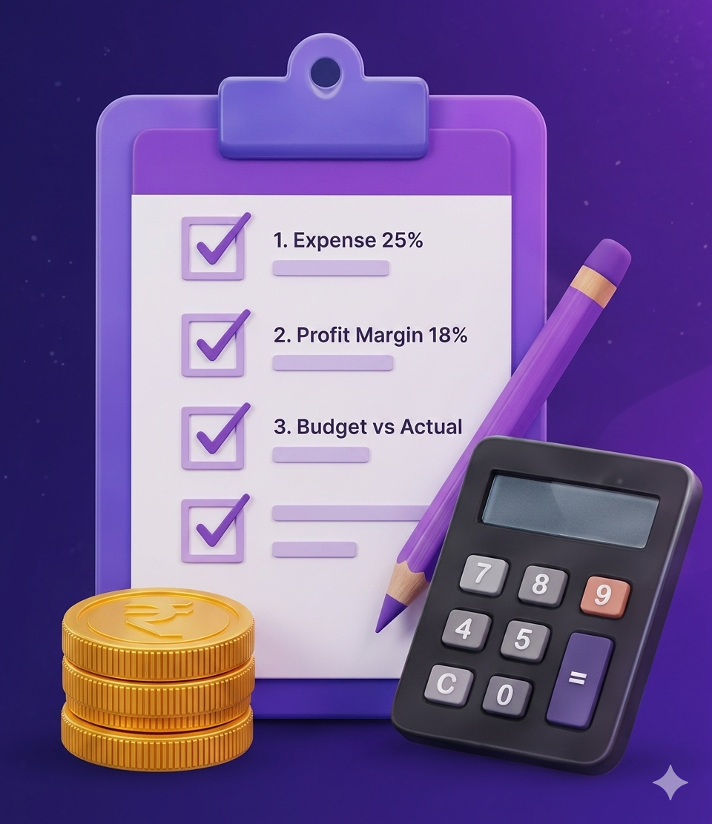

FEATURES
Add Expenses
View Expenses
Category Report
AI Suggestion
Auto Save to CSV File

Slide 5




TECHNOLOGIES USED
Python
Pandas
CSV File
Handling
Groq AI
Programming
Data Analysis
Storage
intelligent suggestions

Slide 6




PROJECT WORKFLOW
User Input
Store
Save CSV
Analyze
AI Output

Slide 7

PROJECT STRUCTURE (FILES)
expense_project/
Main program (Manu)
Main.py
expense.py
Expense class (Modal)
File_handler.py
Save & Load data
analysis.py
Reports using pandas
Ai_helper.py
AI suggestions
data.csv
Stored data

Slide 8
EXPENSE.PY
EXPLANATION
expense.py
Expense class is created using OOP concept
class Expense:
def __init__(self,amount, category,date):
self.amount = amount
self.category = category
self.date = date
Constructor initializes amount, category and date
Objects are created for every expense entry
Data is stored using self keyword

Slide 9
📁FILE_HANDLER.PY
File_handler.py
Explanation
import os
from expense import Expense
def save_to_file(expenses):
try:
path = os.path.join(os.path.dirname(__file__), "data.csv“)
print("Saving to:", path)
with open(path, "w") as file:
for e in expenses:
file.write(f"{e.amount},{e.category},{e.date}\n")
except Exception as e:
print("Save Error:", e)
Stores expense data in CSV file
Loads saved data when application starts
Uses file handling for data persistence
def load_from_file():
expenses = []
try:
path = os.path.join(os.path.dirname(__file__), "data.csv")
print("Loading from:", path)
with open(path, "r") as file:
for line in file:
data = line.strip().split(",")
expenses.append(Expense(float(data[0]), data[1], data[2]))
except:
print("File not found")
return expenses
Exception handling prevents file errors

Slide 10
📊ANALYSIS.PY
analysis.py
Explanation
import pandas as pd
import os
def category_report(expenses):
report = {}
for e in expenses:
if e.category in report:
report[e.category] += e.amount
else:
report[e.category] = e.amount
print("\n--- Category Report ---")
print(report)
def analyze():
try:
file_path = os.path.join(os.path.dirname(__file__), "data.csv")
df = pd.read_csv(file_path, names=["Amount", "Category", "Date"])
print("\n--- Category Wise Total Expense ---")
print(df.groupby("Category")["Amount"].sum())
except Exception as e:
print("Error:", e)
Used pandas library for data analysis
CSV data is loaded into DataFrame
groupby() calculates category-wise expense
Generates expense reports automatically

Slide 11
🤖AI Helper.PY
ai_helper.py
Explanation
client = Groq(
api_key="********"
)
response = client.chat.completions.create(
model="llama-3.3-70b-versatile",
messages=[
{
"role": "user",
"content": prompt
}
]
)
Integrated Groq AI API
Uses LLM model for smart suggestions
Generates AI-based financial advice
User can ask finance-related questions

Slide 12
Expense MANAGEMENT OUTPUT
Add Expanse Output
View Expense Output
C: \FinanceTracker>python main.py
===== FINANCE TRACKER WITH AI ASSISTANCE ====
Add Expense
Enter amount: 500
Enter category: Food
Enter date (DD-MM-YYYY): 05-05-2026
Expense added successfully!
-----------------------------------
1. Add Expense
Enter amount: 300
Enter category: Travel
Enter date (DD-MM-YYYY): 06-05-2026
Expense added successfully!
-----------------------------------
Add Expense
Enter amount: 1200
Enter category: Shopping
Enter date (DD-MM-YYYY): 07-05-2026
Expense added successfully!
Press any key to continue...
C:\FinanceTracker>python main.py
===== FINANCE TRACKER WITH AI ASSISTANCE =====
2. View Expenses
+---------------+---------------+---------------+
| | | |
+---------------+---------------+---------------+
| 500 | Food | 05-05-2026 |
| 300 | Travel | 06-05-2026 |
| 1200 | Shopping | 07—05-2026 |
| 800 | Bill | 08-05-2026 |
| 600 | Entertainment | 09-05-2026 |
| 400 | Food | 10-05-2026 |
| 250 | Travel | 11-05-2026 |
+---------------+---------------+---------------+
TOTAL Expenses: 4050
Press any key to continue...
Amount
Category
Date
Track and manage daily expenses efficiently

Slide 13






ANALYSIS & Suggestion output
PANDAS REPORT OUTPUT
AI SUGGESTION OUTPUT
C:\FinanceTracker>python main.py
===== FINANCE TRACKER WITH AI SUGGESTION =====
4. AI Financial Suggestion
Analysis your expenses...
AI Suggestion:
+----------------------------------------------+
| You are spending the most on shopping (1200).|
| Try reducing unnecessary purchases. |
| |
| Your Food expenses are also high. |
| Consider cooking at home to save more. |
| |
| Keep tracking your expenses and |
| Stick to your budget! |
+----------------------------------------------+
Press any key to continue...
C:\FinanceTracker>python main.py
===== FINANCE TRACKER WITH AI ASSISTANCE=====
3. Expense Report (Category Wise)
Generating report...
+--------------------+--------------------+
| Category | Total Amount |
+--------------------+--------------------+
| Food | 900 |
| Travel | 550 |
| Shopping | 1200 |
| Bills | 800 |
| Entertainment | 600 |
+--------------------+--------------------+
Total Expenses: 4050
Press any key to continue
Track
Expenses
Analysis
Expenses
Get Ai
Suggestions
AI + Analysis =
Smarter Financial Decision

Slide 14



BENEFITS
🧾 Helps users track daily expenses
📈 Improves financial awareness
🤖 Generates smart AI suggestions
💾 Saves expense data automatically
🖥 Easy to use menu-driven system
📊 Provides category-wise analysis
“Smart expense tracking with AI-powered insights”

Slide 15

⚠ CHALLENGES FACED
📂 File path and CSV loading issues
💾 Handling save and load errors
🐞 Debugging Python exceptions
🤖 Integrating Groq AI API
📦 Managing pandas installation
💬 Making the AI responses interactive
🚀 “Every challenge improved the project and learning experience”.

Slide 16

🚀 FUTURE ENHANCEMENTS
📊 Graphical dashboard using charts
🔐 User login and authentication system
🎤 Voice-enabled AI assistant
🧠 Monthly budget prediction
📱 Mobile application integration
☁ Cloud database connectivity
✨ “The project can be expanded with advanced AI and cloud features.”

Slide 17
🏁CONCLUSION
🤖 Successfully developed an AI-powered Expense Tracker
📂 Implemented file handling and data analysis
💡 Integrated Groq AI for smart financial suggestions
📊 Used pandas for category-wise expense reporting
🖥 Built an interactive and user-friendly system
🧠 “Combining Python, Data Analysis, and AI for smarter financial management.”

Slide 18

THANK YOU !
Any Question ?

